Slide 1






Efficient Semi-Supervised Tooth Instance Segmentation in Panoramic X-rays Using
ResUnet50 and SAM Networks
Authors：Xinge Guo, Wenxi Liu
答辩学生：小U荔
指导老师：小U荔
Department of Biomedical Engineering, Shenzhen University, Shenzhen, China
2021222003@email.szu.edu.cn

Slide 2

CONTENTS
01
Research Background and Motivation
02
Data Preprocessing and Network Architecture
03
Semi-Supervised Learning Strategy and Training Strategy
04
Experimental Evaluation

Slide 3


01
Research Background and Motivation

Slide 4
1. Challenge
Tooth Instance Segmentation in 2D Panoramic X-ray Images
2. Charicteristics
国内现状概述
(1) Task: teeth instance segmentation rather than just tooth region segmentation
(2) Dataset: 2000+ 2D X-ray imags spanning all age groups and pathological effects
(3) Evaluation: segmentation accuracy (Dice, NSD, mIoU, IA) and segmentation efficiency (GPU consumption, running time)
3. Dataset
Training set: 2380 panoramic X-ray images, including 30 cases with labels and 2350 unlabeled cases
Validation set: 20 panoramic X-ray images

Slide 5
02
Data Preprocessing and Network Architecture

Slide 6
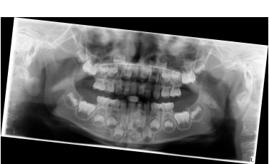
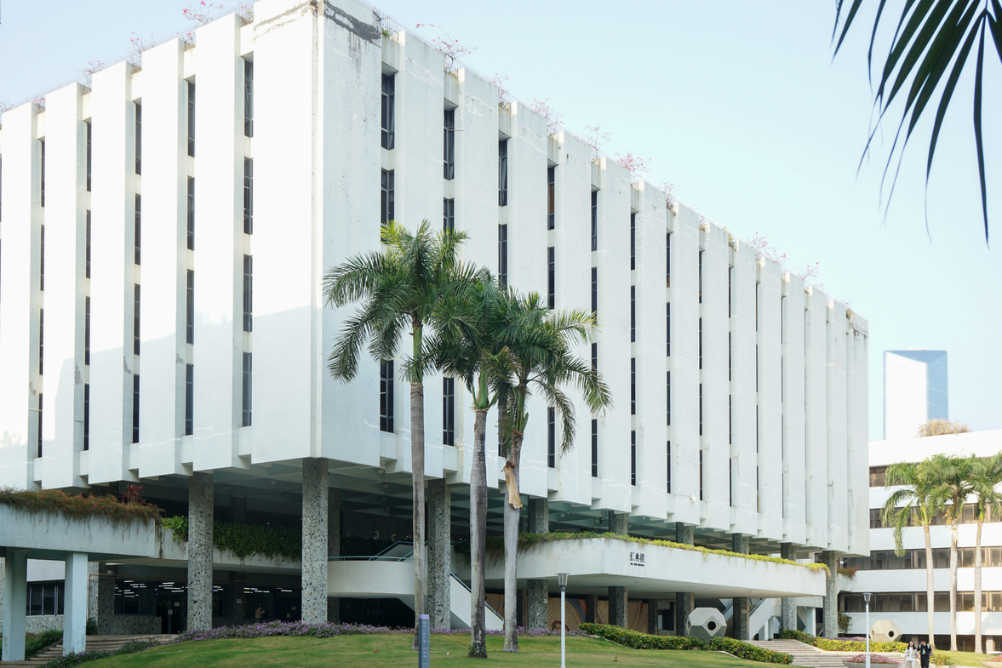

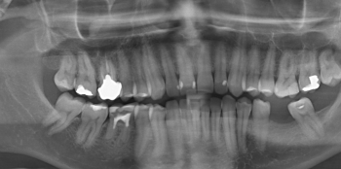
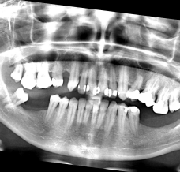
1. Data Augmentation
Data Augmentation and Quantity Expansion for Labeled Samples
Random Rotation
Sliding Window Cropping
Brightness and Contrast Adjustment
Apply a slight rotation of ±10° to the original images
Apply sliding window cropping to the images to ensure that the cropped window covers all teeth within the oral cavity
Enhance the original images using different combinations of brightness and contrast adjustments

Slide 7
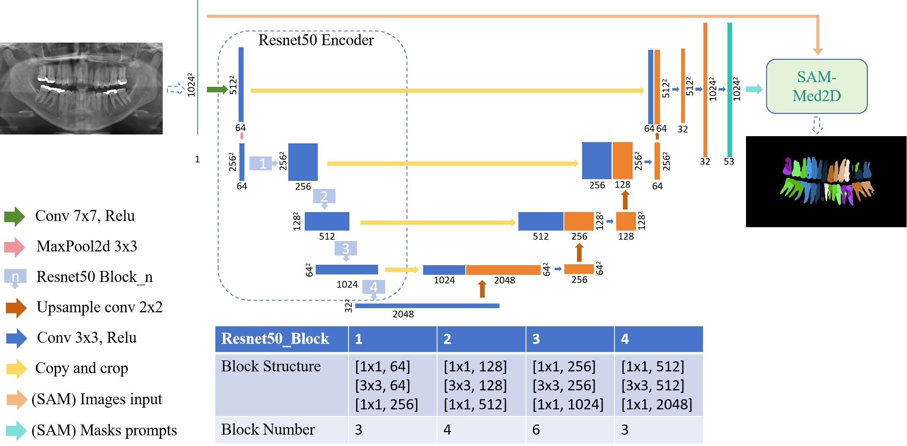
2. Network architecture
The main architecture is UNet-ResNet50 combined with SAM-Med2D, with the SAM2D weights utilizing the ViT-B version.

Slide 8
03
Semi-Supervised Learning and Training Strategy

Slide 9
1. Semi-Supervised Learning Strategy
Train the Teacher Model
train
国内现状概述
Init_model
ResUNet50
Teacher
UNet-Resnet50
valid
labeled images & masks
Train the ResUNet50 model using 900 augmented labeled samples to obtain the teacher model.

Slide 10
Generate Pseudo-Labels
国内现状概述
Teacher
ResUNet50
softed labels
Thr=0.7
unlabeled images
hard labels
Apply the teacher model to the unlabeled data, and after filtering the results, obtain 150 soft labels. Additionally, set a threshold of 0.7 for the soft labels to obtain 150 hard labels.

Slide 11
train
Train the Student Model
Teacher_model
ResUNet50
Student
ResUNet50
国内现状概述
labeled images & masks
valid
loss_function = α×BCEWithLogitsLoss + β ×MSELoss
α=0.8，β=0.2，
BCEWithLogitsLoss will be applied to the hard labels, while MSELoss will be applied to the soft labels.
unlabeled images & hard+soft masks
Train the student model using 900 true labels, 150 pseudo soft labels, and 150 pseudo hard labels along with their corresponding images, based on the checkpoint of the teacher model.

Slide 12
2. Training Strategy
（1）In this experiment, the batch size is set to 4, and the patch size is 1024x1024 pixels.
（2）The Adam optimizer was used, and the training process ran for a total of 300 epochs with an initial learning rate of 0.0002. To optimize the learning rate over time, a cosine annealing schedule was applied, setting the minimum learning rate to 0.00001 after 50 epochs.

Slide 13
04
Experimental Evaluation

Slide 14
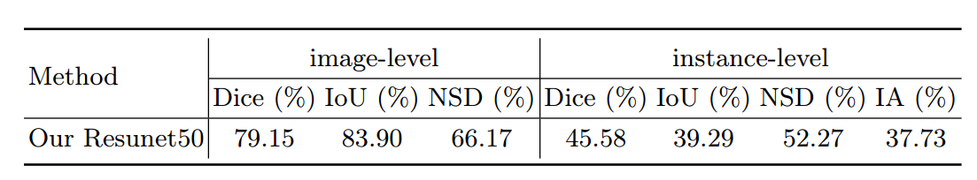
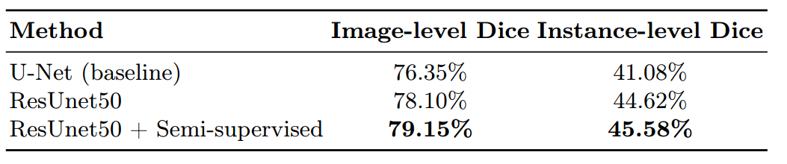
1. Results
2. Ablation experiment

